Slide 1
Reinforcement Learning for
Dynamic Disassembly Line Scheduling
①
②
③
Dynamic scheduling in flexible and hybrid disassembly systems with manual and automated workstations using reward-shaping enhanced reinforcement learning
Deep reinforcement learning-based approach for dynamic disassembly scheduling of end-of-life products
with stimuli-activated self-disassembly
Multi-objective reinforcement learning for dynamic balancing of two-sided human–robot collaborative
disassembly lines
④
⑤
Dynamic Disassembly Planning of End-of-Life Products for Human–Robot Collaboration Enabled by Multi-Agent Deep Reinforcement Learning
Partially observable deep reinforcement learning for multi-agent strategy optimization of human-robot collaborative disassembly: A case of retired electric vehicle battery
CPS Computational Learning Laboratory

Slide 2
①
③
Dynamic scheduling in flexible and hybrid disassembly systems with manual and automated workstations using reward-shaping enhanced reinforcement learning
Multi-objective reinforcement learning for dynamic balancing of two-sided human–robot collaborative
disassembly lines
Multi-objective Optimization
②
Stimuli-activated Workstation
④
Human and Robot have
different optimization objective
Deep reinforcement learning-based approach for dynamic disassembly scheduling of end-of-life products
with stimuli-activated self-disassembly
Dynamic Disassembly Planning of End-of-Life Products for Human–Robot Collaboration Enabledby Multi-Agent Deep Reinforcement Learning
Partial Observation
⑤
Partially observable deep reinforcement learning for multi-agent strategy optimization of human-robot collaborative disassembly: A case of retired electric vehicle battery
CPS Computational Learning Laboratory

Slide 3

Paper 1
Dynamic scheduling in flexible and hybrid disassembly systems
with manual and automated workstations using
reward-shaping enhanced reinforcement learning
Jinlong Wang, Qihuiyang Liang, Min Li, Zelin Qu, Yuanyuan Zhang
Published in: Engineering Applications of Artificial Intelligence
Published Time: 2025
CPS Computational Learning Laboratory
Notes:
动态：工作站故障，工作站输入输出缓冲区堵塞。
flexible：灵活调度人工工作站

Slide 4
01
Problem Description
02
Method Design
03
Experiment Results
Contents
04
Conclusion
CPS Computational Learning Laboratory

Slide 5
01
Problem Description
02
Method Design
03
Experiment Results
Contents
04
Conclusion
CPS Computational Learning Laboratory

Slide 6
Problem Description
Existing disassembly systems rely heavily on fixed automation and limited manual intervention, making it challenging to adapt to dynamic issues such as workstation failures and system bottlenecks.
CPS Computational Learning Laboratory

Slide 7
01
Problem Description
02
Method Design
03
Experiment Results
Contents
04
Conclusion
CPS Computational Learning Laboratory

Slide 8
Method Design
To address these issues, a hybrid disassembly system is developed that integrates manual and automated workstations, allowing for the flexible variation of manual resources as needed to optimize the disassembly process, with a focus on reducing time and maximizing profit.
An enhanced proximal policy optimization (PPO) algorithm with Reward-Shaping is introduced to address the challenge of sparse rewards in reinforcement learning.
CPS Computational Learning Laboratory

Slide 9
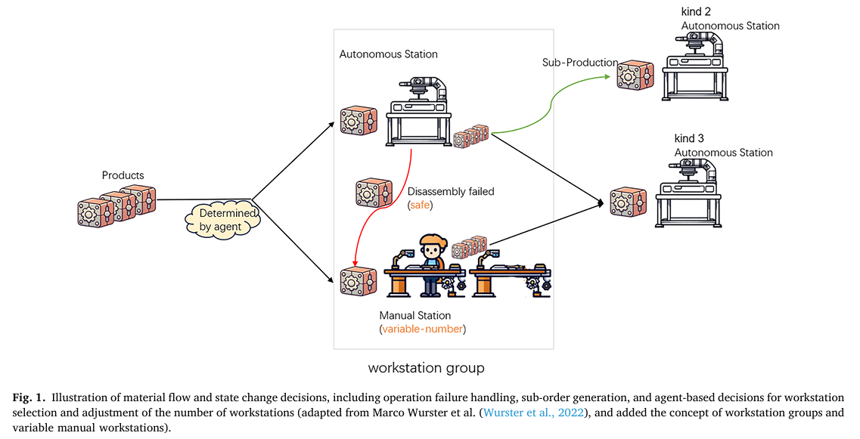
Method Design
System model and problem description
CPS Computational Learning Laboratory
Notes:
CQL：保守强化学习，主要解决模型对未见过动作的价值过估计问题，通过在损失函数中加入L_CQL约束项实现
公式7是对公式5中最大动作价值进行了一个近似

Slide 10
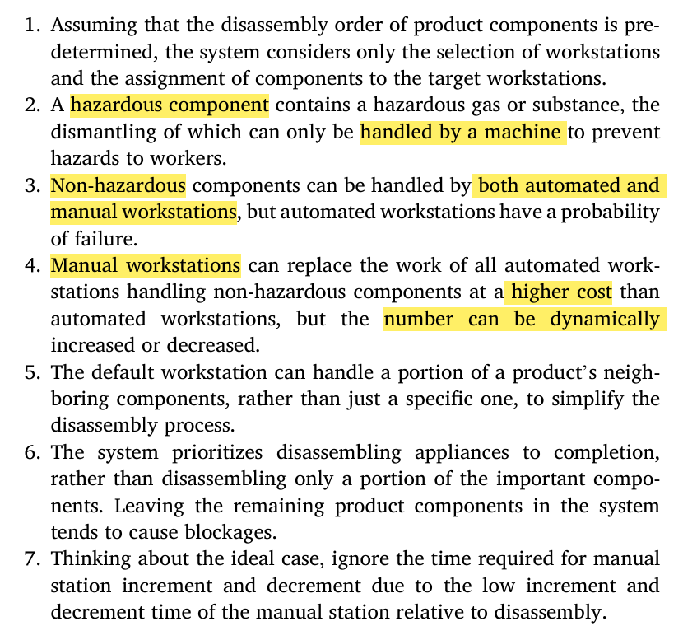
Method Design
System model and problem description
CPS Computational Learning Laboratory

Slide 11
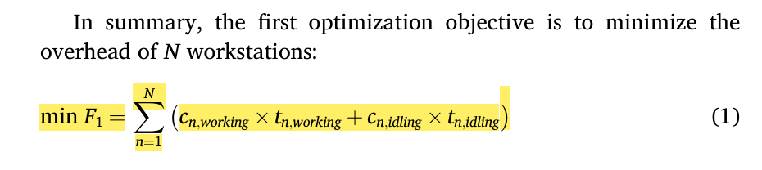
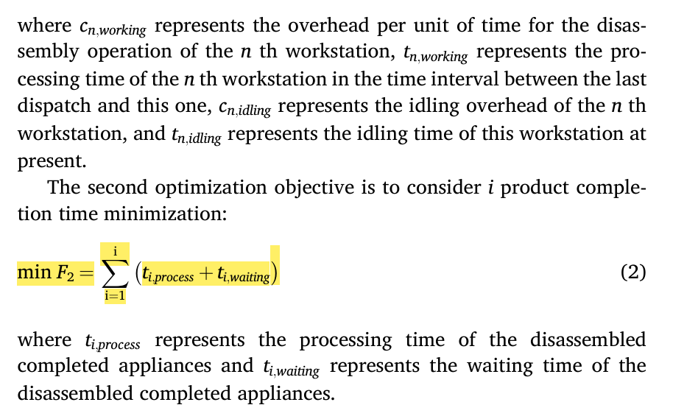
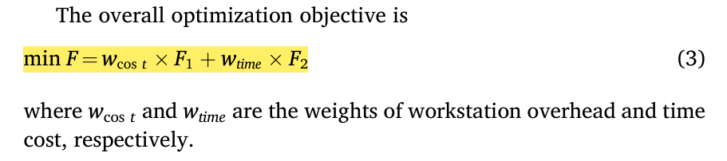
Method Design
System model and problem description
CPS Computational Learning Laboratory

Slide 12
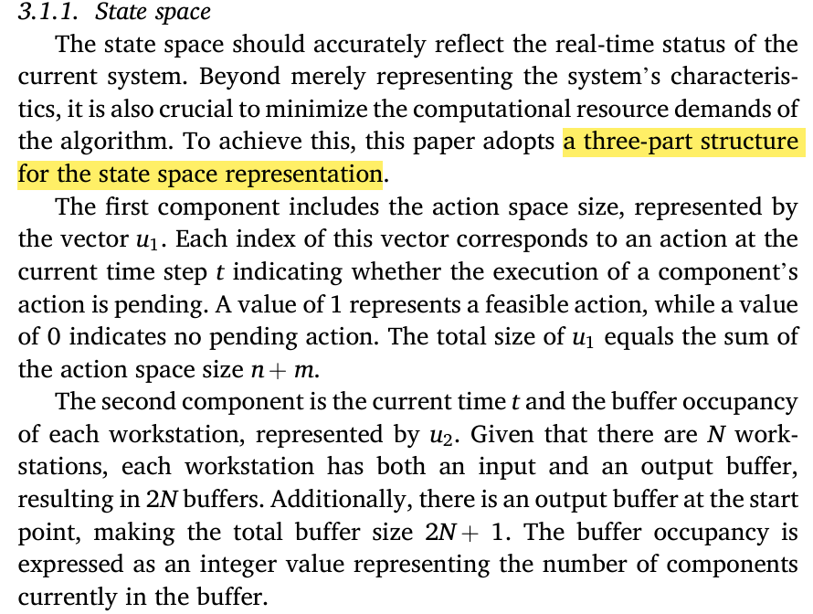
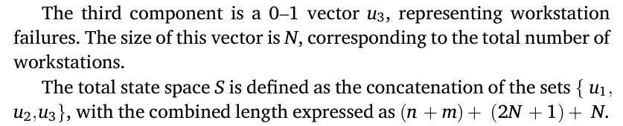
Method Design
Method description——State space
CPS Computational Learning Laboratory

Slide 13
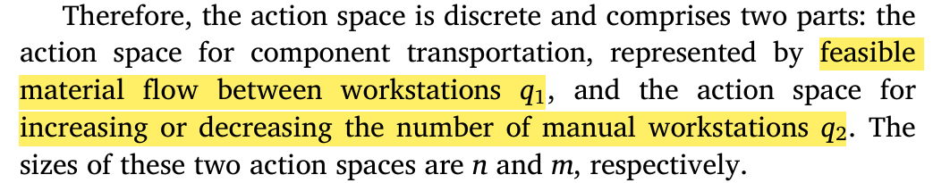
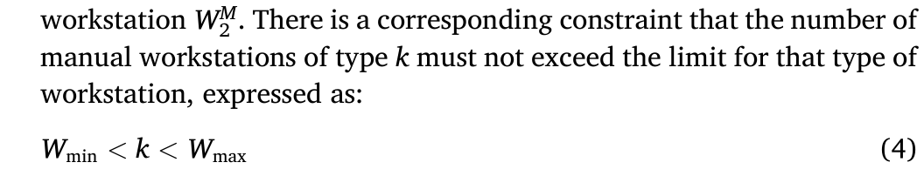
Method Design
Method description——Action space
CPS Computational Learning Laboratory

Slide 14
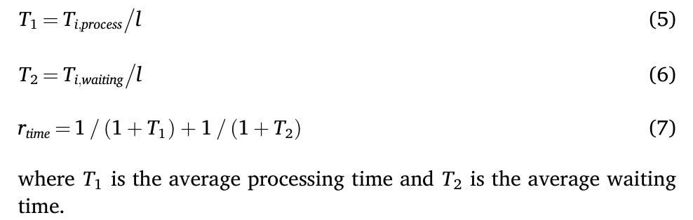
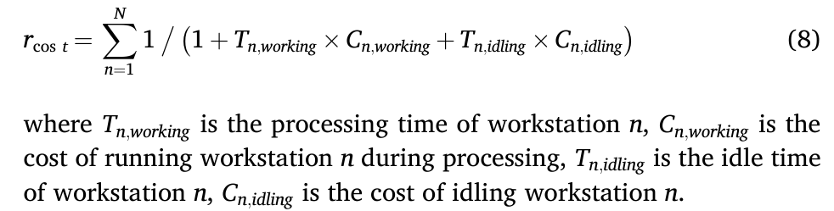
Method Design
Method description—— Reward functions and reward-shaping
CPS Computational Learning Laboratory

Slide 15
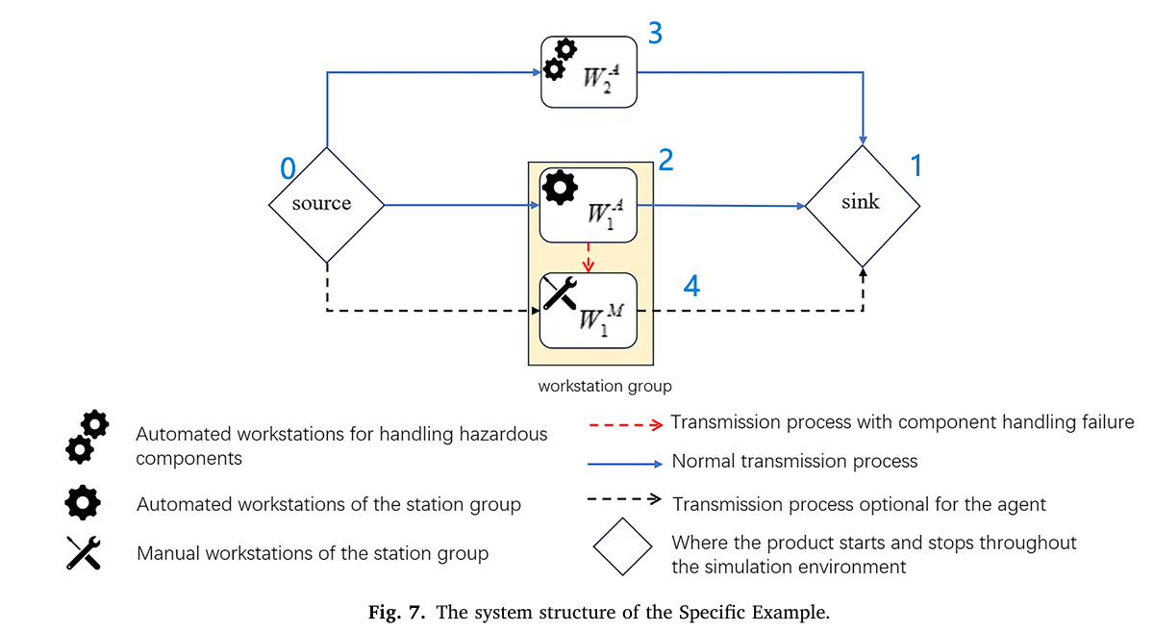
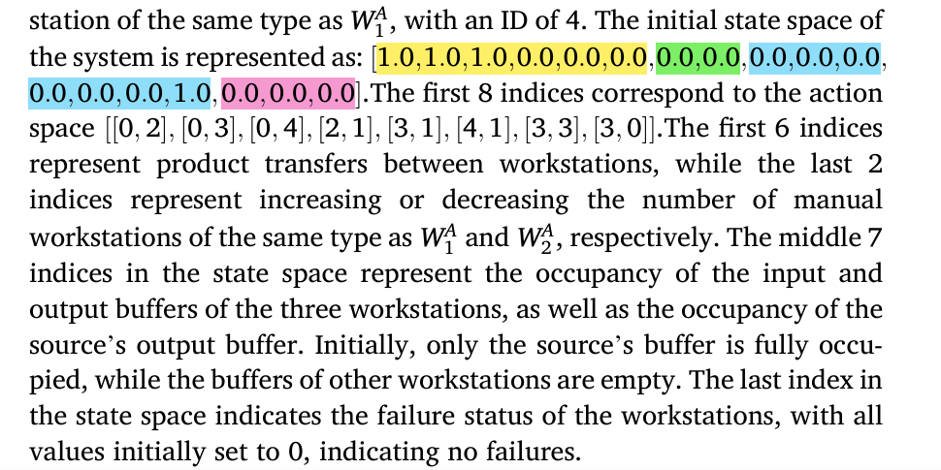
Method Design
Specific Example
CPS Computational Learning Laboratory
Notes:
18=6+2+7+3
6：6个工作站迁移路径
2：2个工作站是否有人数增减
7：7个buffer的占用率
3：3个工作站是否故障

Slide 16
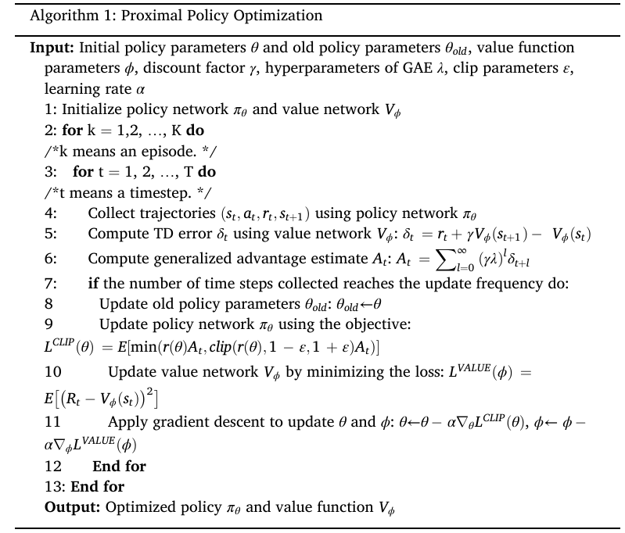
Method Design
CPS Computational Learning Laboratory

Slide 17
01
Problem Description
02
Method Design
03
Experiment Results
Contents
04
Conclusion
CPS Computational Learning Laboratory

Slide 18
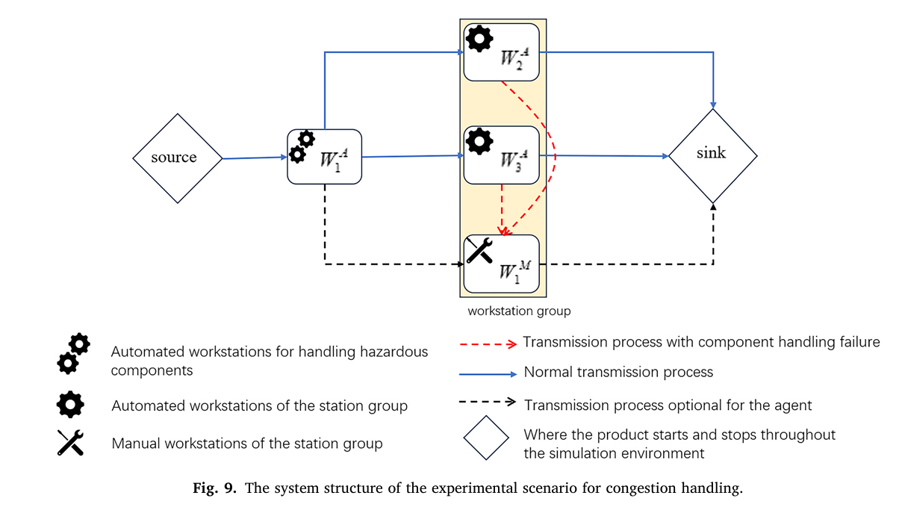
Experiment Results
Disassembly Case 1
CPS Computational Learning Laboratory
Notes:
产品供应无限
wa1：处理危险拆解任务
wa2、wa3、wm1:同类型的工作站

Slide 19
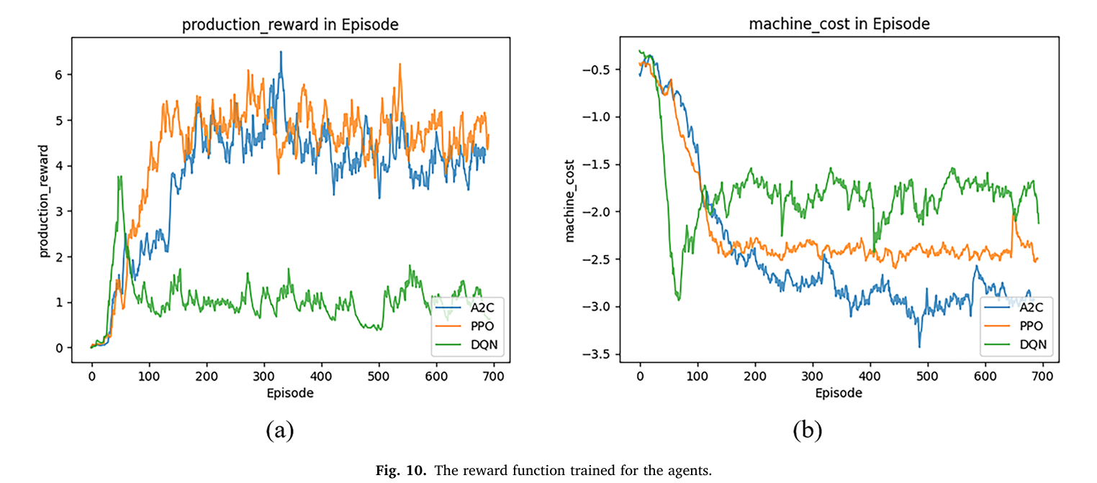
Experiment Results
Disassembly Case 1
CPS Computational Learning Laboratory
Notes:
r_action：根据拆解产品的数量给的奖励
dqn为了总体奖励最大，压低成本，少开工作站，成本自然低

Slide 20
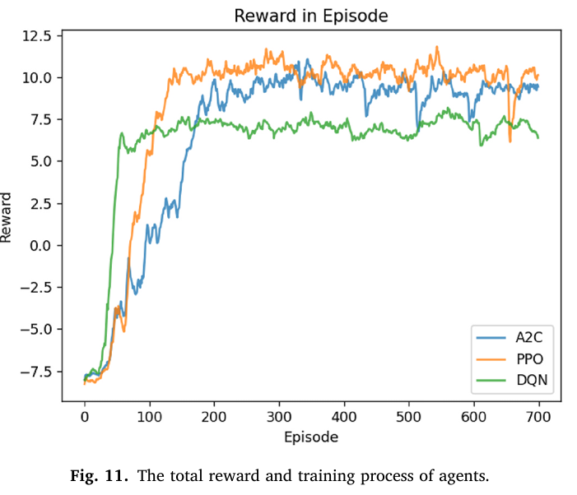
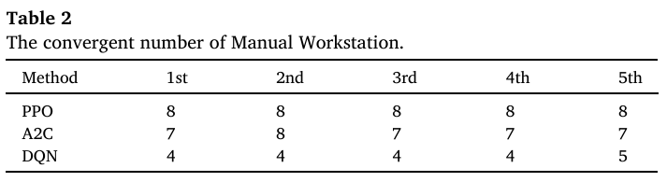
Experiment Results
Disassembly Case 1
CPS Computational Learning Laboratory
Notes:
总的奖励比较：时间奖励+损耗奖励+拆解步骤奖励
尽管dqn整体奖励很高，但是它是在节约成本的基础上换来的，拆解产品的数量很少
ppo在结合处理时间+损耗+拆解任务数量的优化目标下是最优的
表2：5次独立重复实验，每种算法设置的独立工作站数量

Slide 21
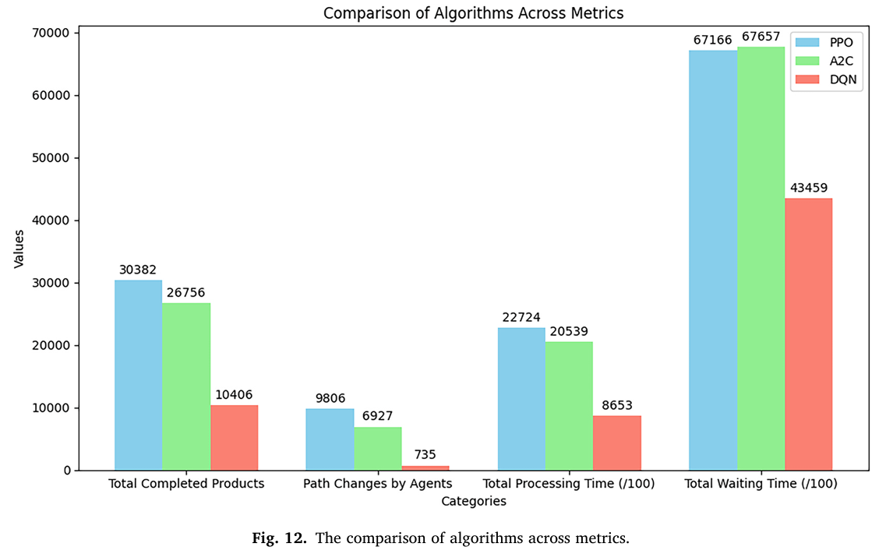
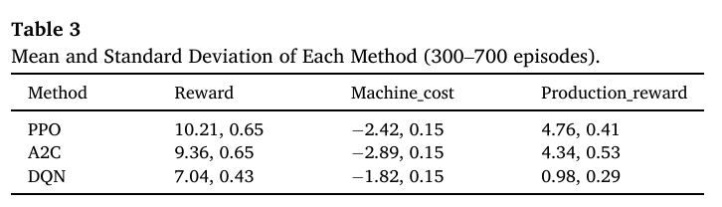
Experiment Results
Disassembly Case 1
CPS Computational Learning Laboratory
Notes:
拆解产品数量，路径变换次数，总处理时间，等待时间

Slide 22
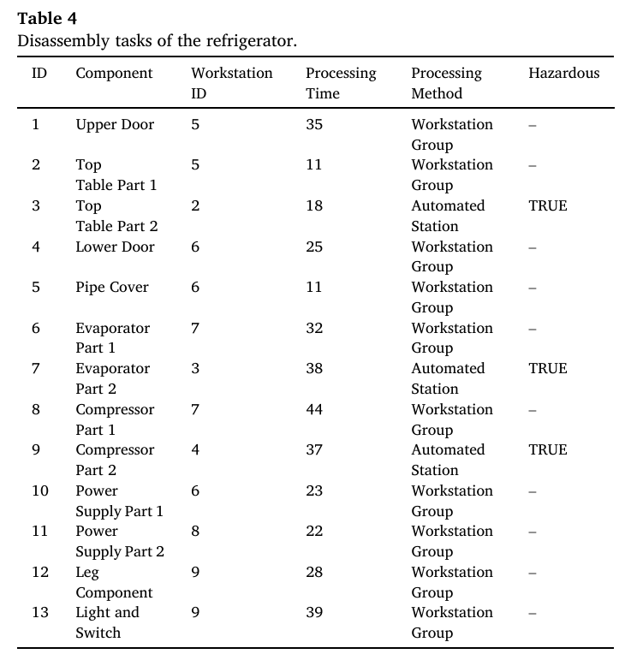
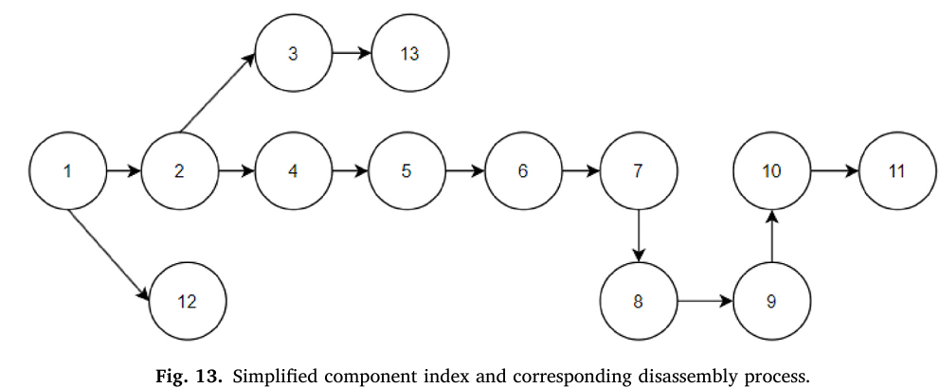
Experiment Results
Disassembly Case 2
CPS Computational Learning Laboratory
Notes:
更复杂的拆解案例

Slide 23
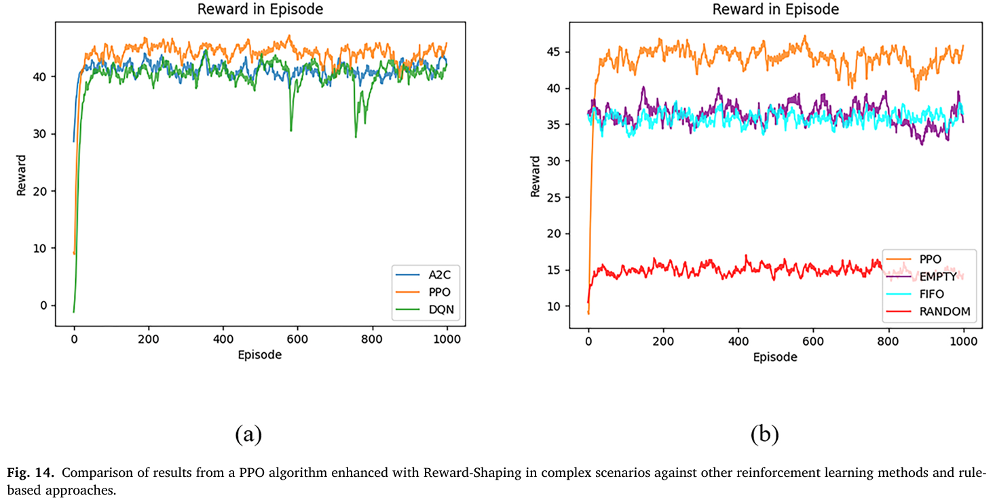
Experiment Results
Disassembly Case 2
CPS Computational Learning Laboratory
Notes:
完成的拆解任务多，奖励更高

Slide 24
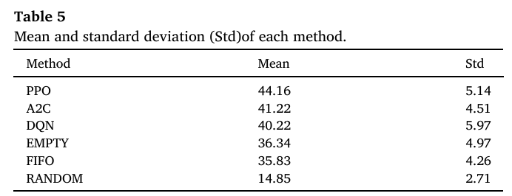
Experiment Results
Disassembly Case 2
CPS Computational Learning Laboratory

Slide 25
01
Problem Description
02
Method Design
03
Experiment Results
Contents
04
Conclusion
CPS Computational Learning Laboratory
CPS Computational Learning Laboratory
2
18

Slide 26
Conclusion
By leveraging an enhanced Proximal Policy Optimization (PPO) algorithm with Reward-Shaping, this research introduces a dynamic scheduling framework capable of significantly improving the efficiency and adaptability of disassembly operations
Future work will build on multi-agent research foundations to explore integrating more complex product types and further refine the Reward-Shaping mechanism to enhance real-time decision-making in industrial environments.
CPS Computational Learning Laboratory
Notes:
系统能够根据设备故障（workstation failures）、系统瓶颈（bottlenecks）和产品状态，即时调整路径和资源。

Slide 27
Paper 2
Deep reinforcement learning-based approach for
dynamic disassembly scheduling of end-of-life products
with stimuli-activated self-disassembly
Muyue Han, Lingxiang Yun, Lin Li
Publish Journal: Journal of Cleaner Production
Published Time: 2023
CPS Computational Learning Laboratory
Notes:
动态：零件缺失或者拆解失败
导致不同产品的库存动态变化，会导致爆仓

Slide 28
01
Problem Description
02
Method Design
03
Experiment Results
Contents
04
Conclusion
CPS Computational Learning Laboratory

Slide 29
01
Problem Description
02
Method Design
03
Experiment Results
Contents
04
Conclusion
CPS Computational Learning Laboratory

Slide 30
Problem Description
The newly emerged 4D printing technology enables the fabrication of stimuli-responsive reconfigurable structures, outlining new ways to achieve non-destructive and simultaneous self-disassembly of components with different geometry.
However, large uncertainties and increased process dynamics have also emerged directly pertaining to the real-time scheduling in disassembly lines with self-disassembly workstations, which the existing scheduling methods are not equipped to handle.
CPS Computational Learning Laboratory

Slide 31
01
Problem Description
02
Method Design
03
Experiment Results
Contents
04
Conclusion
CPS Computational Learning Laboratory

Slide 32
Method Design
This study proposes a deep reinforcement learning-based dynamic scheduling approach for EOL product disassembly with stimuli-activated self-disassembly.
A constrained multi-agent deep reinforcement learning (C-QMIX) approach is developed to maximize the cumulative profit over a scheduling horizon, incorporating the dynamic batch mixing schemes in self-disassembly processes, uncertainties in returned product quality and residual values, failures and sequence changes in disassembly operations, and line-side buffer capacity constraints.
CPS Computational Learning Laboratory

Slide 33
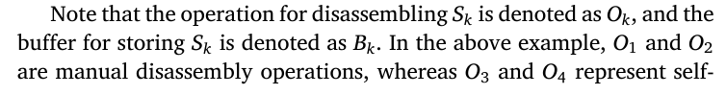
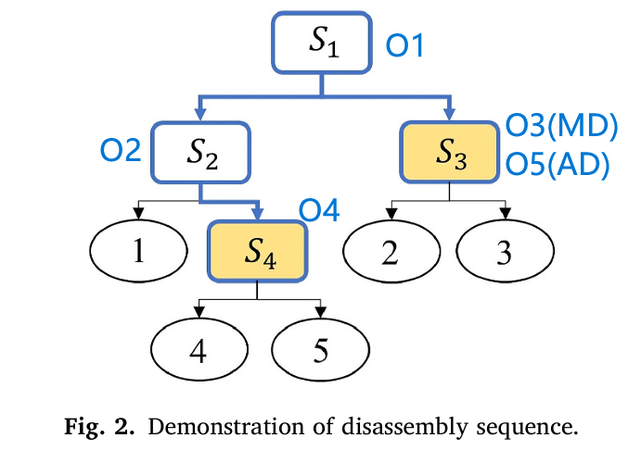
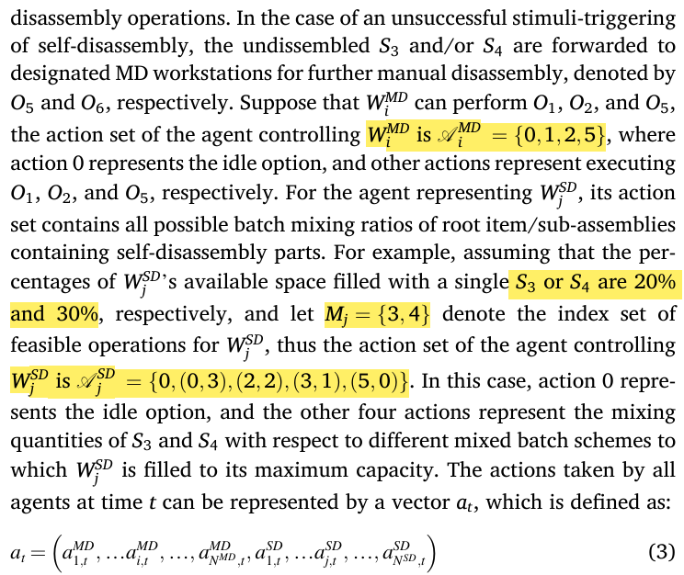
Method Design
Constrained markov decision process
CPS Computational Learning Laboratory
Notes:
S2、S3、S4是在拆解过程中的3类子产品
O1-O5是拆解产品所需要的操作
1-5：完整的5个回收部件
人工工作站动作：空闲+子产品对应的操作
自拆解站动作：空闲+可加工产品的混合比例

Slide 34
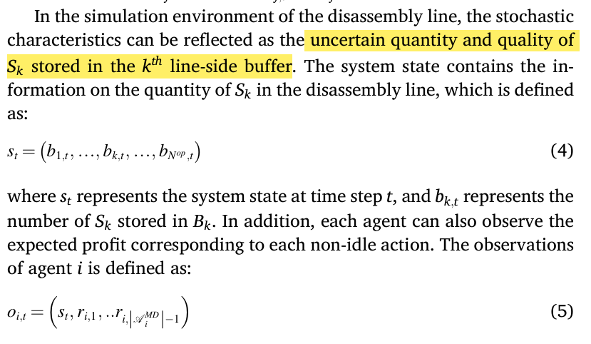
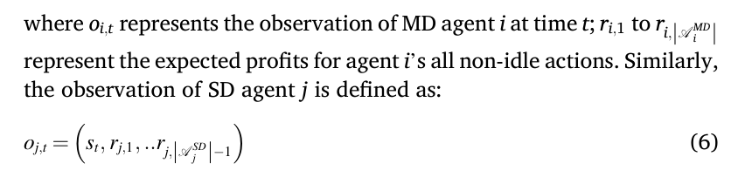
Method Design
Constrained markov decision process
CPS Computational Learning Laboratory
Notes:
状态：拆解过程中每种产品存储在对应缓冲区的数量，缓冲区的容量有限
观测：缓冲区容量+有效拆解动作中的拆解产品带来的价值

Slide 35
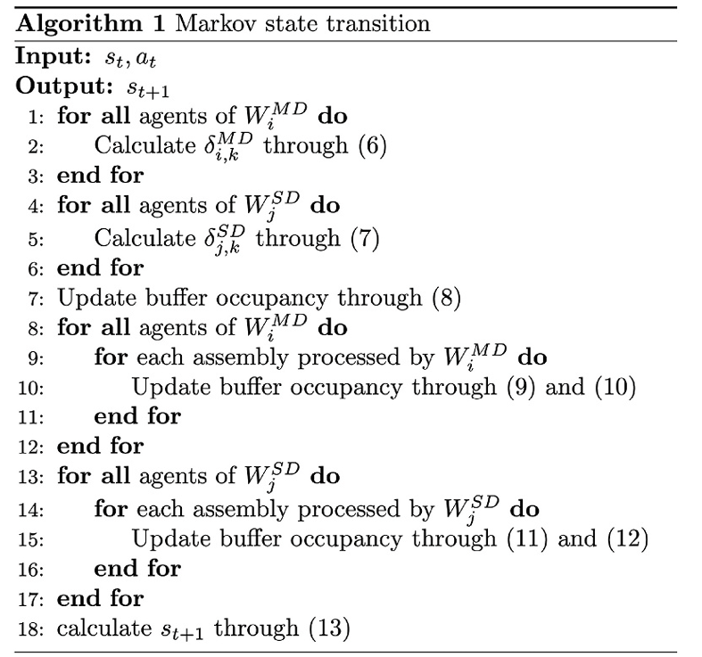
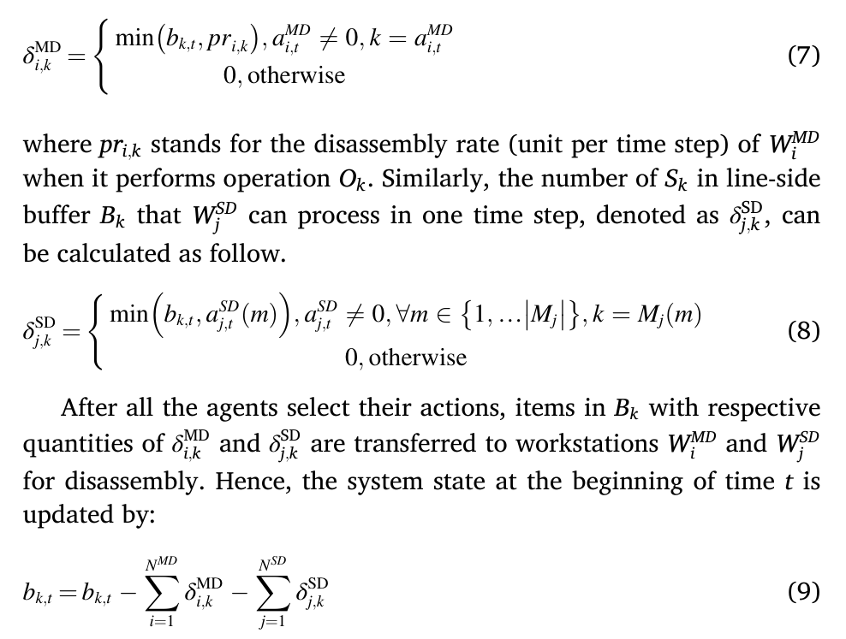
Method Design
Markov state transition
CPS Computational Learning Laboratory
Notes:
根据工作站智能体选择的动作，更新不同产品的库存
公式7：单个时间步，人工工作站智能体i拆解产品k的数量
公式8：单个时间步，自拆解工作站智能体j拆解产品k的数量
公式9：产品k的库存

Slide 36
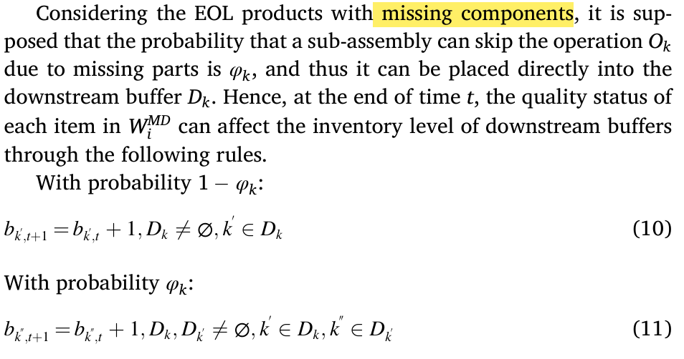
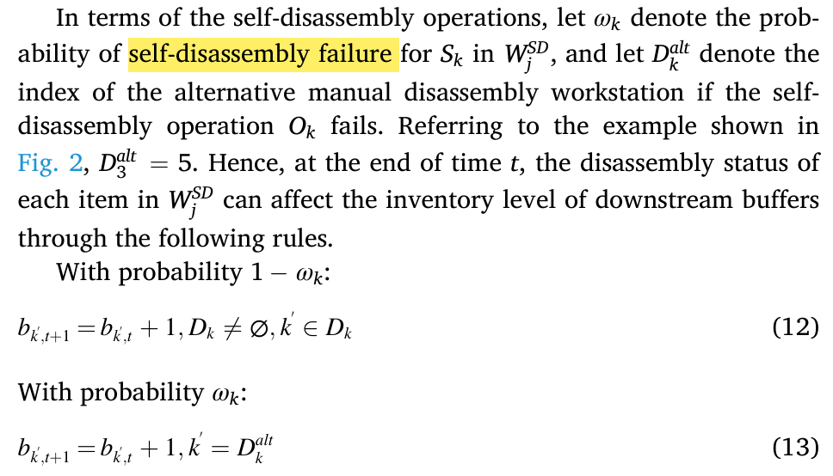
Method Design
Markov state transition
CPS Computational Learning Laboratory
Notes:
根据工作站智能体选择的动作，更新不同产品的库存
人工工作站会出现产品缺失。自拆解工作站会出现拆解失败
以拆解单个产品举例
公式10：子产品k不缺失，下游子产品+1
公式11：子产品k缺失，下游的下游子产品+1
公式12：子产品k拆解成功，下游子产品+1
公式13：子产品k拆解失败，由人工工作站确定下游子产品数量

Slide 37
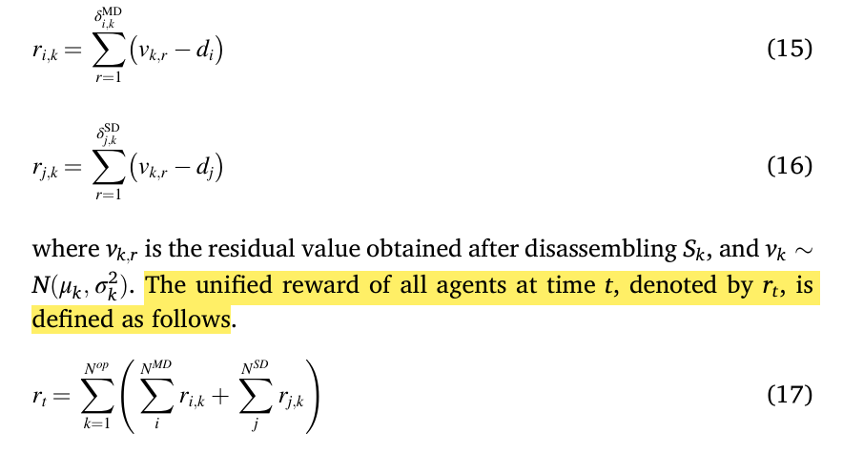
Method Design
Reward
CPS Computational Learning Laboratory
Notes:
奖励：工作站拆解产品的价值-工作站损耗

Slide 38
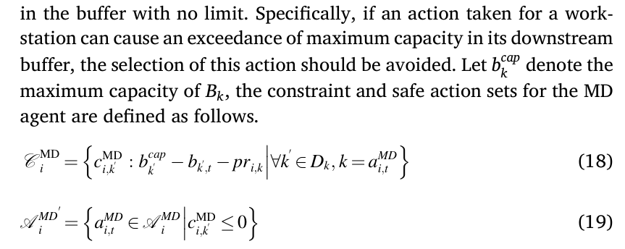
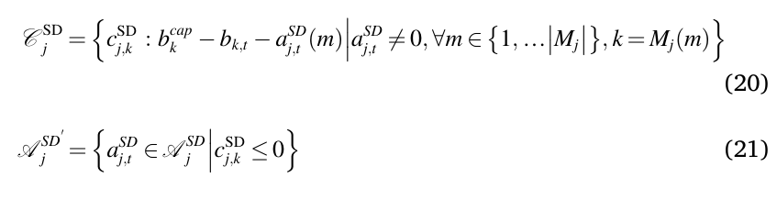
Method Design
Constraints and safe action set
CPS Computational Learning Laboratory
Notes:
判断工作站智能体选择完对应动作，每个下游产品的库存变化，若超出规定的容量，认为是非法动作，掩码掉

Slide 39
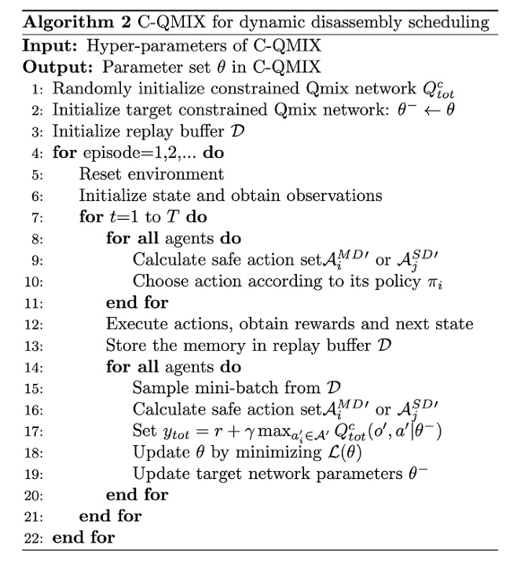
Method Design
Constrained multi-agent deep reinforcement learning
CPS Computational Learning Laboratory

Slide 40
01
Problem Description
02
Method Design
03
Experiment Results
Contents
04
Conclusion
CPS Computational Learning Laboratory

Slide 41
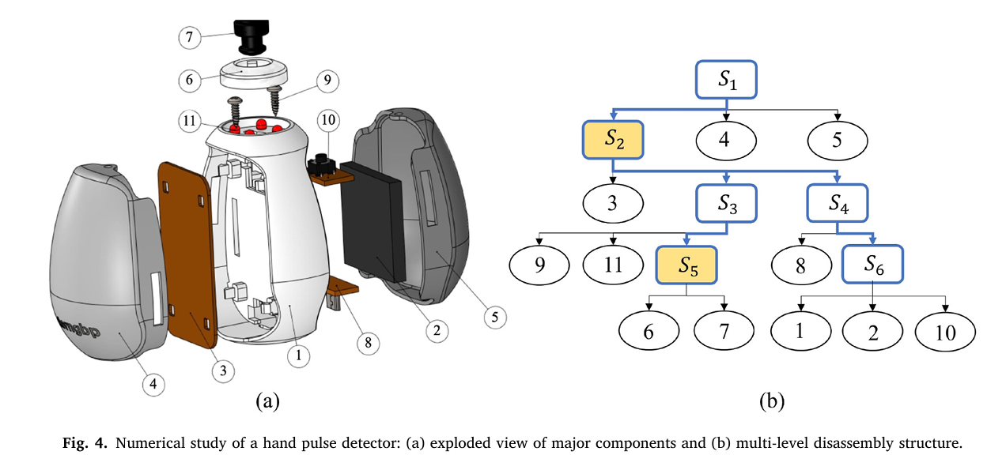
Experiment Results
Construction of numerical experiments
CPS Computational Learning Laboratory

Slide 42
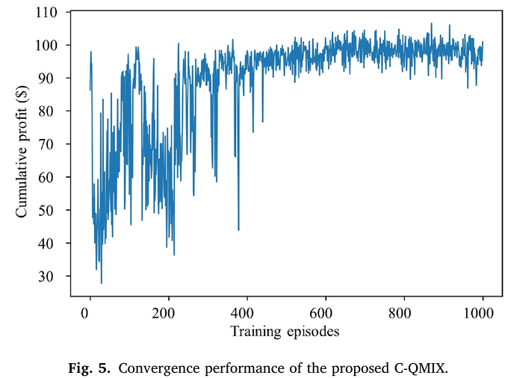
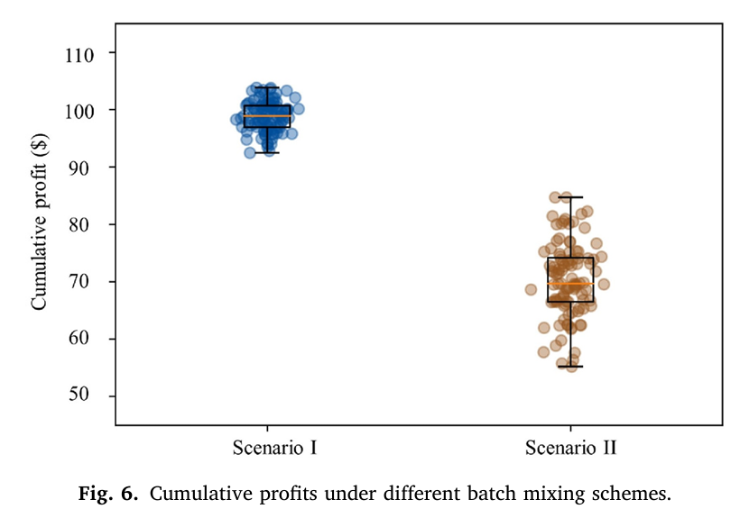
Experiment Results
Simulation results
CPS Computational Learning Laboratory
Notes:
加载80个产品，每个回合50个step，获得的累积收益
图5：dqn：前期随机选择动作，后面会选择价值最高的动作，随机性降低，训练更稳定
图6：改变自拆解工作站智能体的动作空间，第一组是[0,(2,0),(1,2),(0,4)]，第二组是[0,(1,2)]。第一组动作空间可以根据拆线的情况，每次动态调整拆解不同比例的产品，效果会更好一些。

Slide 43
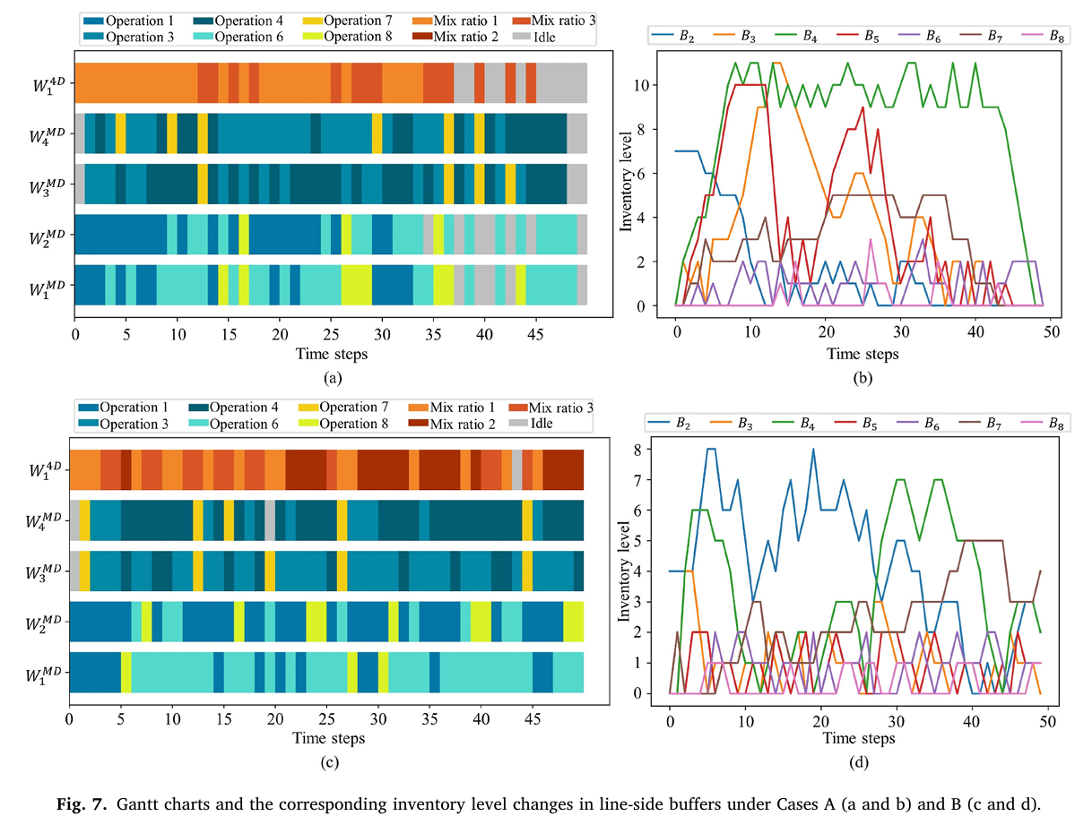
Experiment Results
Disassembly scheduling under different returned product quantities
CPS Computational Learning Laboratory
Notes:
改变回收产品的数量
gatt图+子产品库存变化
第一组：给定回收产品数量下（80）
第二组：回收产品数量无限
第一组分析：第一组在调度快结束的时候，出现大量工作站空闲。可能是由于50个调度步足够完成给定产品数量下的拆解工作，所以排布比较分散。
从库存上看，，而且对不同子产品的价值也没有什么偏好。
第二组分析：因为拆解量大，50步肯定拆不完，所以工作站没有什么空闲。排布比较紧密。
从库存上看，在50步的时候，高价值子产品B2的库存比较低，可以看出对不同子产品的价值也是有偏好的

Slide 44
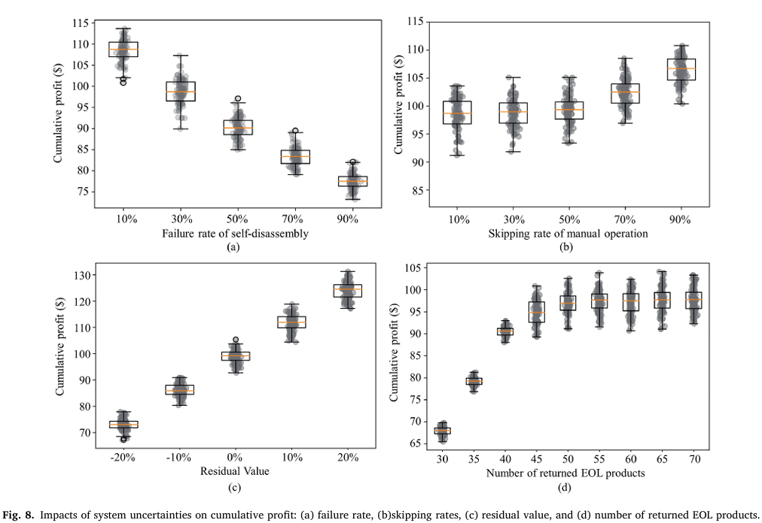
Experiment Results
Sensitivity analyses
CPS Computational Learning Laboratory
Notes:
1、改变自拆解工作站拆解失败的概率；
因为自拆解工作站拆解失败概率增加，会由人工工作站处理，增加了额外成本，所以利润下降
2、改变工件缺失的概率：
因为高价值部件在后面，o1-o4缺失后，获得高价值部件的速度更快，所以利润增加
3、改变拆解部件的价值；
因为回收部件价值增加，所以利润增加
4、改变加载拆解产品的数量；
因为拆解系统可拆解产品的数量是有限的，所以开始时利润增加，到达拆解系统的拆解能力上限后，利润基本保持不变

Slide 45
01
Problem Description
02
Method Design
03
Experiment Results
Contents
04
Conclusion
CPS Computational Learning Laboratory
CPS Computational Learning Laboratory
2
18

Slide 46
Conclusion
The disassembly problem is formulated as a constrained Markov decision process considering different forms of uncertainties.
A deep reinforcement learning algorithm C-QMIX is proposed for maximizing the disassembly profit over the scheduling horizon.
In addition, it is also worth modifying the proposed method to address the scheduling and real-time control in multi-product partial disassembly or incorporate additional factors related to the scheduling over consecutive stages.
CPS Computational Learning Laboratory

Slide 47
Paper 3
Multi-objective reinforcement learning for dynamic balancing of
two-sided human–robot collaborative disassembly lines
Jinlong Wang, Min Li, Fanyun Meng, Haoran Zhao, Xin Sun
Publish Journal: Computers & Industrial Engineering
Published Time: 2026
CPS Computational Learning Laboratory
Notes:
动态：机器人工作站拆解失败

Slide 48
01
Problem Description
02
Method Design
03
Experiment Results
Contents
04
Conclusion
CPS Computational Learning Laboratory

Slide 49
01
Problem Description
02
Method Design
03
Experiment Results
Contents
04
Conclusion
CPS Computational Learning Laboratory

Slide 50
Problem Description
Current research seldom addresses disassembly line layout design tailored for large-size products, and studies on managing disassembly uncertainties remain limited.
CPS Computational Learning Laboratory

Slide 51
01
Problem Description
02
Method Design
03
Experiment Results
Contents
04
Conclusion
CPS Computational Learning Laboratory

Slide 52
Method Design
This study proposes a two-sided human–robot collaborative disassembly line system that improves space utilization and disassembly efficiency through coordinated bilateral operations..
A multi-objective proximal policy optimization (MOPPO) algorithm is developed to enhance decision-making. By randomly sampling preferences during training, the agent learns a unified policy model that generalizes across different preferences and approximates the pareto front.
CPS Computational Learning Laboratory
Notes:
MOPPO学习不同偏好（优化目标权重）下的策略

Slide 53
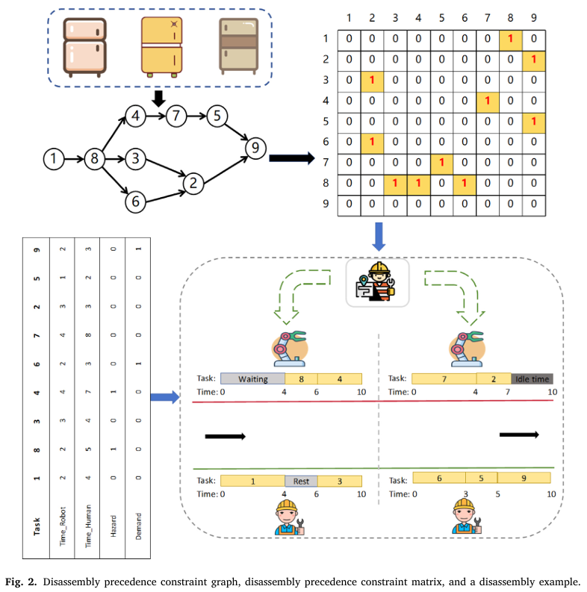
Method Design
Problem description
CPS Computational Learning Laboratory
Notes:
左图：拆解电冰箱的任务约束，对应的先序约束图矩阵
右图：表格是每个任务对应的拆解时间、危险和优先级标识

Slide 54
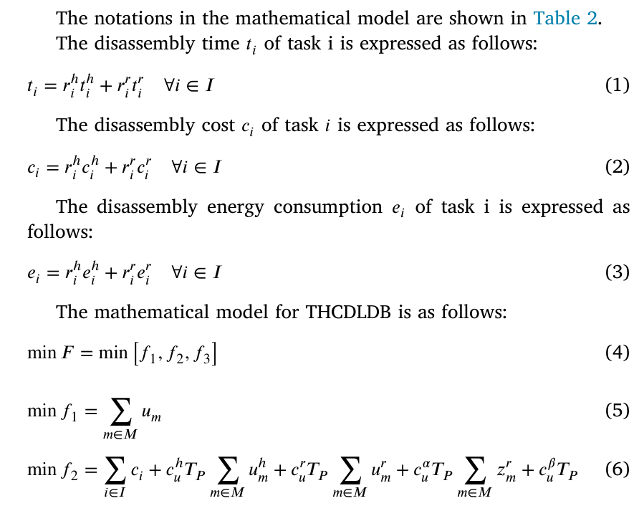
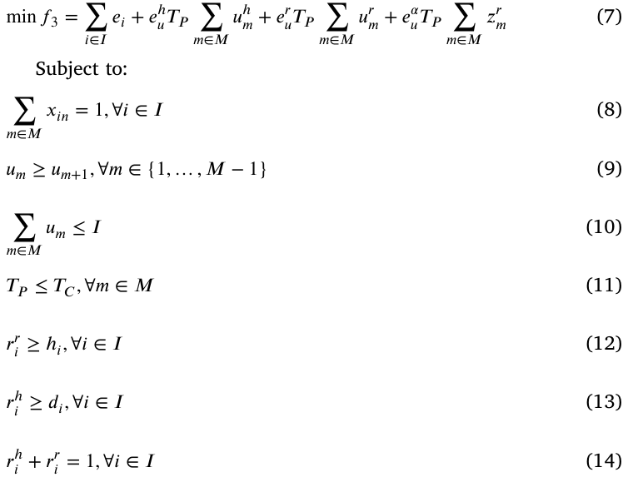
Method Design
Mathematical model
CPS Computational Learning Laboratory
Notes:
公式1：任务i的拆解时间
公式2：任务i的拆解成本
公式3：任务i的拆解能量消耗
公式4：最小化工作站数量，拆解成本，能量消耗
最小化工作站数量，拆解损耗之间的冲突：最小化工作站数量，导致单个工作站的任务量增加，节拍时间增加，容易导致两侧的工作站等待时间边长，能耗增加
最小化拆解成本，能量消耗之间的冲突：最小化拆解成，全让人拆，但是人拆的慢，能耗增加
最小化工作站数量，拆解成本：最小化工作站数量，系统鲁棒性差，当遇到机器人工作站拆解失败时，人工介入会增加拆解成本
公式5：最小化工作站数量
公式6：最小化拆解成本
公式7：最小化能量消耗
公式8：一个任务只能分配给一个工作站
公式9：前面工作站优先开放
公式10：开放工作站数量小于任务数量
公式11：实际循环时间<=理论循环时间
公式12：危险任务只分配给机器人工作站
公式13：高需求任务只分配给人工工作站
公式14：任务只能分配给一个人工工作站或机器人工作站

Slide 55
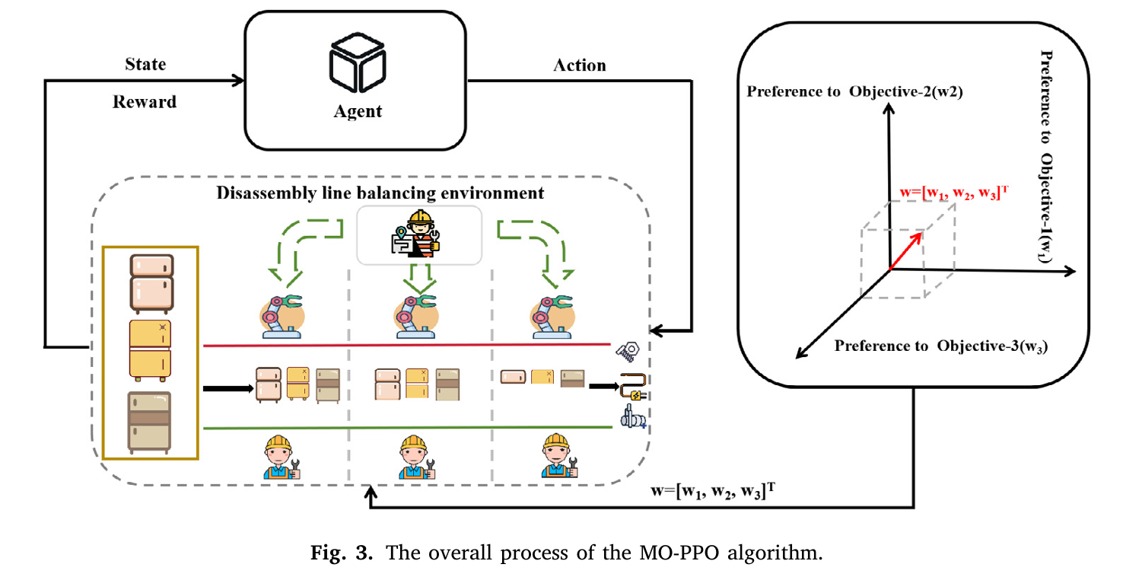
Method Design
MO-PPO
CPS Computational Learning Laboratory

Slide 56
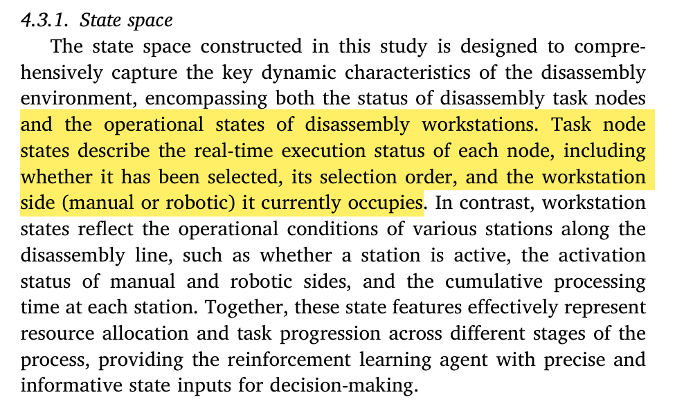
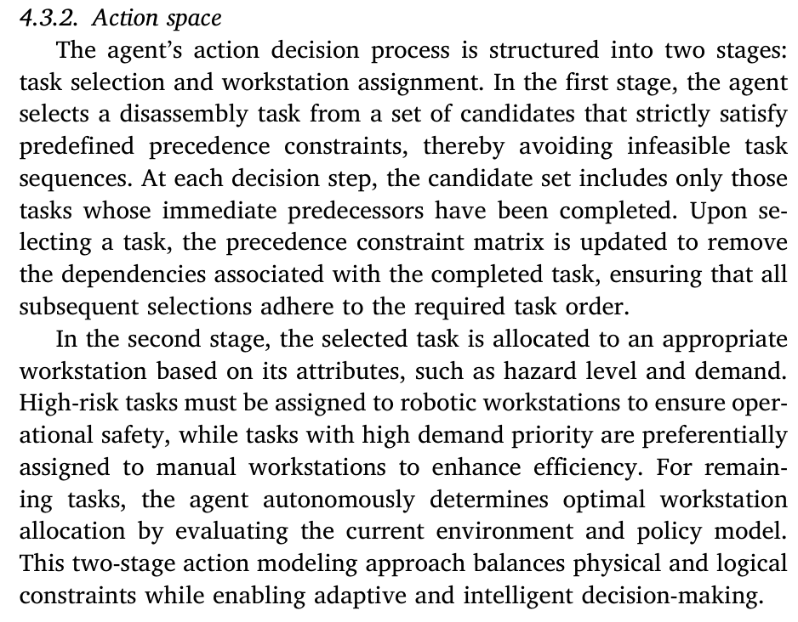
Method Design
MO-PPO
CPS Computational Learning Laboratory
Notes:
状态：任务节点信息+工作站的信息
任务节点：是否被选中、选择顺序、所在侧
工作站运行状态：工作站激活状态、该工作站的人工侧或机器人侧是否在工作、累计处理时间
动作：任务分配+工作站分配

Slide 57
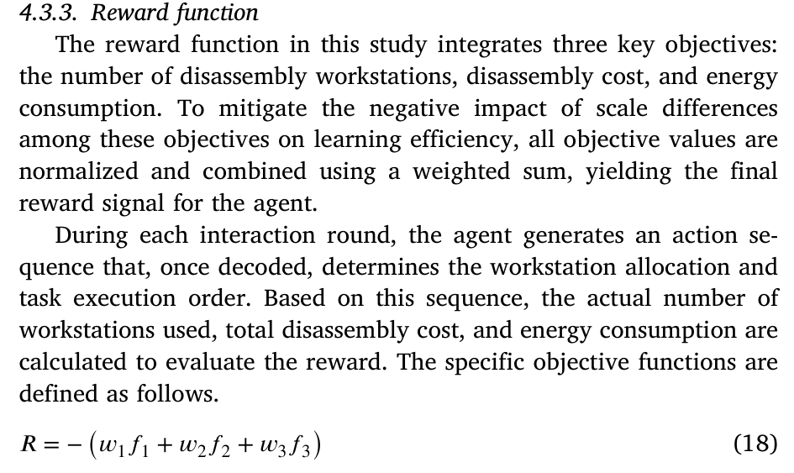
Method Design
MO-PPO
CPS Computational Learning Laboratory
Notes:
奖励：按照采样的偏好向量进行加权不同目标下的奖励

Slide 58
01
Problem Description
02
Method Design
03
Experiment Results
Contents
04
Conclusion
CPS Computational Learning Laboratory

Slide 59
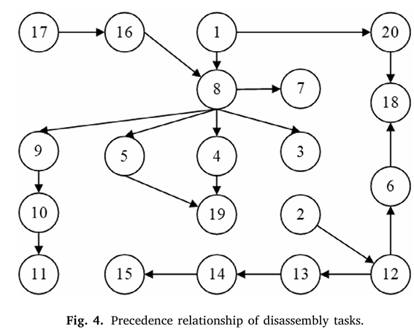
Experiment Results
Disassembly instances
CPS Computational Learning Laboratory
Notes:
拆解电冰箱

Slide 60

Experiment Results
Disassembly instances
CPS Computational Learning Laboratory
Notes:
拆解电冰箱

Slide 61


Experiment Results
Comparative experiment
CPS Computational Learning Laboratory
Notes:
MO-PPO与MO-DQN, MO-D3QN对比，mo-ppo效果更好，更稳定
表6：与强化学习算法对比，一组调度结果，分配情况，工作时间，循环时间（取工作站的最长工作时间），三个优化目标：工作站数量、成本、损耗

Slide 62

Experiment Results
Comparative experiment
CPS Computational Learning Laboratory
Notes:
训练过程中，mappo的3个优化目标的变化曲线，在最小化工作站数量、拆解成本、能量损耗均实现了最优

Slide 63

Experiment Results
Comparative experiment
CPS Computational Learning Laboratory
Notes:
训练过程中，mappo的3个优化目标的变化曲线，在最小化工作站数量、拆解成本、能量损耗均实现了最优

Slide 64

Experiment Results
Comparative experiment
CPS Computational Learning Laboratory
Notes:
表7：和启发式算法的对比，一组调度结果，分配情况，工作时间，循环时间（取工作站的最长工作时间），三个优化目标：工作站数量、成本、损耗
mo-ppo实现和启发式算法一样的效果

Slide 65

Experiment Results
Dynamic rebalancing
CPS Computational Learning Laboratory
Notes:
任务拆解时间变化，重新计算新的解所需要的时间

Slide 66

Experiment Results
Dynamic rebalancing
CPS Computational Learning Laboratory
Notes:
工作站拆解失败，重新计算新的解所需要的时间

Slide 67

Experiment Results
Dynamic rebalancing
CPS Computational Learning Laboratory
Notes:
不同场景下的均值和方差，moppo和启发式算法差不多

Slide 68

Experiment Results
Dynamic rebalancing
CPS Computational Learning Laboratory
Notes:
改变节拍时间，分别对应高压（50、60）——标准（70）——宽松场景（80、90、100）
高压（50、60）：算法的主要任务是只要能排得进去就行，很难再去优化成本或能耗
宽松(80\90\100)：约束更宽松，解空间变大，
证明了传统元启发式算法在搜索空间变大时，容易陷入局部最优，而 MO-PPO 能够持续挖掘 Pareto 前沿，找到最优解。

Slide 69
01
Problem Description
02
Method Design
03
Experiment Results
Contents
04
Conclusion
CPS Computational Learning Laboratory
CPS Computational Learning Laboratory
2
18

Slide 70
Conclusion
This study addresses the multi-objective optimization problem of human–robot collaborative two-sided disassembly line balancing.
This approach not only enables real-time decision-making and the flexible balancing of conflicting objectives but also overcomes the limitations of traditional methods, significantly enhancing adaptability and decision-making efficiency.
CPS Computational Learning Laboratory

Slide 71
Paper 4
Dynamic Disassembly Planning of End-of-Life
Products for Human–Robot Collaboration Enabled
by Multi-Agent Deep Reinforcement Learning
Yiqun Peng, Weidong Li, Yong Zhou, Duc Truong Pham
Published in: IEEE TRANSACTIONS ON AUTOMATION SCIENCE AND ENGINEERING
Published Time: 2025
CPS Computational Learning Laboratory
Notes:
人的不确定性：拆解时间和拆解任务选择不确定，会影响后续任务的调度

Slide 72
01
Problem Description
02
Method Design
03
Experiment Results
Contents
04
Conclusion
CPS Computational Learning Laboratory

Slide 73
01
Problem Description
02
Method Design
03
Experiment Results
Contents
04
Conclusion
CPS Computational Learning Laboratory

Slide 74
Problem Description
High labor costs and the limited ability of robots to perform intricate disassembly tasks have led to the increasing use of human-robot collaboration (HRC) for disassembly.
The uncertainty is that the disassembly time for a task and the task sequence selection by a human during execution might differ from the pre-defined disassembly plan so that dynamic disassembly planning for subsequent tasks is necessary.
CPS Computational Learning Laboratory

Slide 75
01
Problem Description
02
Method Design
03
Experiment Results
Contents
04
Conclusion
CPS Computational Learning Laboratory

Slide 76
Method Design
HRC-based dynamic disassembly task assignment is innovatively modeled using the Stackelberg model to facilitate human-centric HRC.
The improved MAPPO (i-MAPPO) algorithm is novel because it integratesthe Stackelberg equilibrium into the MAPPO advantage function to address Stackelberg policies in dynamic HRC scenarios effectively.
CPS Computational Learning Laboratory
Notes:
1、针对多智能体强化学习，提出一个全场景下的跨任务迁移方法（异构、同构、竞争、协作）
2、利用GMM对源域中不同智能体的策略进行分类聚合
3、软注意力机制，在目标域中训练智能体时，对来自不同智能体策略的每个模块输出进行加权，输入到目标域策略网络中。

Slide 77

Method Design
CPS Computational Learning Laboratory
Notes:
Stackelberg 均衡：当领导者选了一个动作，跟随者针对这个动作选了最好的应对；而领导者预判到了这一切，所以他一开始选的就是那个“能诱导跟随者做出对自己最有利反应”的动作。这就是 Stackelberg 均衡。
人是leader：能够预判机器人采取的动作，从而选择能够使人获得最大价值（拆解效率）的动作。
机器人是follower：在人采取动作之后，选择一个最大价值（安全性）的动作

Slide 78



Method Design
Form of the Policies
CPS Computational Learning Laboratory
Notes:
（2）先序任务约束
（3）状态，包含任务约束矩阵n*n，人对于每个任务的进度n*1，机器对于每个人物的进度n*1
（4）动作，机器人决策时要考虑人的动作

Slide 79




Method Design
Return Values of the Human and the Robot
CPS Computational Learning Laboratory
Notes:
人的目标是最小化拆解时间，机器人的目标是最大化人机之间的安全距离。
（6）机器人的奖励：根据状态、人和机器人的动作来确定，
如果任一方处于等待（wait）状态，通常被认为是绝对安全的（无碰撞风险），奖励设为 0
否则根据人机之间的距离，设置奖励
（8）表示当前步骤实际的拆解时间
（10）人的累积回报
（11）机器人的累积回报

Slide 80

Method Design
Policies That Satisfy Stackelberg Equilibrium
CPS Computational Learning Laboratory
Notes:
到达Stackelberg 均衡 条件下，人和机器最优策略的表征，最优策略=Stackelberg 均衡
在t时刻的状态价值最大

Slide 81




Method Design
Solving optimal policy with the i-MAPPO algorithm
CPS Computational Learning Laboratory
Notes:
15、16：人和机器人的动作动作优势价值

Slide 82


Method Design
Solving optimal policy with the i-MAPPO algorithm
CPS Computational Learning Laboratory
Notes:
17：人的actor损失
18：机器人的actor损失
19：人的critic损失
20：机器人的critic损失

Slide 83
01
Problem Description
02
Method Design
03
Experiment Results
Contents
04
Conclusion
CPS Computational Learning Laboratory

Slide 84

Experiment Results
Case Study
CPS Computational Learning Laboratory
Notes:
EV-LIB：EoL electric vehicle lithium-ion battery

Slide 85

Experiment Results
Performance Analysis
CPS Computational Learning Laboratory
Notes:
验证系统感知的实时性，系统能够极快地算出人和机器人之间的距离，快到足以支持实时的安全避障

Slide 86


Experiment Results
Performance Analysis
CPS Computational Learning Laboratory
Notes:
图6(a)训练过程中拆解时间变化，
图6(b)训练过程中机器人与人之距离变化（越远越安全）
图7：每一轮中人完成拆解任务的时间都是不确定的
X轴 (Main task index)：代表不同的拆解任务编号，每一个编号代表拆卸某一个具体的零件。
Y轴 (Test index)：代表测试轮次。作者对这套流程进行了 10 次重复测试（Index 1 到 10）。
Z轴 (Human disassembly time)：代表人类完成该任务所用的时间（秒）。

Slide 87


Experiment Results
Performance Analysis
CPS Computational Learning Laboratory
Notes:
图8：证明的是 i-MAPPO 算法的鲁棒性
最后拆解时间是1169，最优是1147，只慢了20s。
即使人类工人像图中这样4次打乱计划，算法也能实时重规划（让机器人是该干活还是该等待），最终在不发生事故的前提下，以非常接近最优解的时间完成所有工作。
表4：人类遵循算法建议的不同概率下，系统性能变化
人类遵循算法建议的概率，改变任务次数的均值，拆解时间均值和标准差，距离的均值和标准差
人类越少捣乱，拆解时间越短，人机距离越远。人类越配合，算法就能找到质量越高的解
GD：Generational Distance，评价收敛性，即算法找到的解，离理论上最优解（真实 Pareto 前沿）有HV多近
HV：Hypervolume，超体积，HV 越大：说明算法找到的解集质量越高，覆盖面越广，给出的选择越好。

Slide 88


Experiment Results
Performance Analysis
CPS Computational Learning Laboratory
Notes:
i-MAPPO和其他启发式算法和多智能体强化学习算法的对比
图9(a)：这是一个散点图，x轴是拆解时间，y轴是安全距离，每一个点代表算法生成的一个任务分配方案，越靠近左上越好（拆解最快且离人最远）
图9(b)：评价解的质量，GD：离最优解的距离，HV：解的覆盖范围
表5：抗干扰能力测试 ，设置不同人听从算法的概率，测试10次，成功的概率，i-MAPPO全部成功，且解的质量最高

Slide 89


Experiment Results
Performance Analysis
CPS Computational Learning Laboratory
Notes:
图10：i-MAPPO算法和不同多智能体强化学习算法的训练时间对比，i-MAPPO最短
表6：i-MAPPO算法和不同多智能体强化学习算法的推理时间对比，i-MAPPO效果也比较好

Slide 90
01
Problem Description
02
Method Design
03
Experiment Results
Contents
04
Conclusion
CPS Computational Learning Laboratory
CPS Computational Learning Laboratory
2
18

Slide 91
Conclusion
By proposing optimal disassembly task assignment policies that adhere to the Stackelberg model, this paper offers a robust solution for dynamic disassembly planning that balances efficiency and safety in HRC.
In future work, the factors that influence human uncertainty in HRC and their impact on disassembly task assignments can be explored in greater depth.
CPS Computational Learning Laboratory

Slide 92
Paper 5
Partially observable deep reinforcement learning for
multi-agent strategy optimization of human-robot collaborative disassembly: A case of retired electric vehicle battery
Jiaxu Gao, Guoxian Wang, Jinhua Xiao, Pai Zheng, Eujin Pei
Publish Journal: Robotics and Computer-Integrated Manufacturing
Published Time: 2024
CPS Computational Learning Laboratory
Notes:
动态：人的不确定性，全局任务信息未知的不确定性

Slide 93
01
Problem Description
02
Method Design
03
Experiment Results
Contents
04
Conclusion
CPS Computational Learning Laboratory

Slide 94
01
Problem Description
02
Method Design
03
Experiment Results
Contents
04
Conclusion
CPS Computational Learning Laboratory

Slide 95
Problem Description
Because of the uncertainty of retired EV battery disassembly and the inefficiency of the existing disassembling sequence, it is difficult to be fully accomplish through human-robot collaboration (HRC) disassembly.
CPS Computational Learning Laboratory

Slide 96
01
Problem Description
02
Method Design
03
Experiment Results
Contents
04
Conclusion
CPS Computational Learning Laboratory

Slide 97
Method Design
A partially observable multi- agent reinforcement learning environment is constructed, incorporating the structural aspects of the EV battery and the disassembly task.
The framework is extended to the QMIX-HRC algorithm on the QMIX architecture, specifically designed to tackle the sequence problem in human-robot collaborative disassembly of EV batteries.
CPS Computational Learning Laboratory

Slide 98

Method Design
Multi-agent reinforcement learning
CPS Computational Learning Laboratory

Slide 99

Method Design
Multi-agent reinforcement learning
CPS Computational Learning Laboratory
Notes:
强化学习算法->仿真过程->实际过程
电动车电池的结构拆解，把这些任务分配给人和机器人

Slide 100

Method Design
Modeling and simulations
CPS Computational Learning Laboratory
Notes:
1、开始
2、将任务Tn分配给人或者机器
3、完成任务
4、判断是否存在可加工的任务
是：回到2
否：等待人或者机器人完成任务
5、判断当前层的所有任务是否都完成了
是：进入下一层拆解任务
否：人工再确认

Slide 101

Method Design
Modeling and simulations
CPS Computational Learning Laboratory
Notes:
这个电池里有哪些零件，以及必须按什么顺序、朝哪个方向拆，才不会被卡住。
8个层级，右图标注了拆解反向

Slide 102

Method Design
Modeling and simulations
CPS Computational Learning Laboratory
Notes:
实际电池的结构->拆解任务序列->强化学习中状态空间和观测空间的表征
右上表示了8个任务的层级关系
状态：全局任务的信息
观测：当前执行任务的信息
设计为部分可观测的原因：
1、物理传感器的局限性：机器人的传感器（如摄像头、激光雷达）都有视场角（FOV）和盲区。
机器人只能看到它传感器覆盖范围内的局部信息，无法实时获取整个工作站的完整状态。如果算法依赖全图信息，一旦被挡住就会失效。
2、人类认知的局限性：当工人在拆一颗螺丝时，他的注意力全在手头的工作上，根本无暇顾及整个流水线其他部分的状态。
3、算法落地的现实难度：如果强行输入全状态，状态空间维度会过高，导致计算量大增，难以满足实时控制的需求。

Slide 103

Method Design
Modeling and simulations
CPS Computational Learning Laboratory
Notes:
奖励设置
优化目标是最小化拆解时间、最小化劳动力，每一次拆解都是一种消耗时间和劳动力，所以统一当成了一种损耗
所以优化目标转换成了最小化损耗

Slide 104
01
Problem Description
02
Method Design
03
Experiment Results
Contents
04
Conclusion
CPS Computational Learning Laboratory

Slide 105

Experiment Results
Disassembly experiment analysis
CPS Computational Learning Laboratory
Notes:
Tool Area、Human work area：人类负责处理非标准化的任务，比如剪断线束、拔除接插件、或者处理滑丝的螺栓。这些动作需要极高的灵巧度，目前的机器人很难胜任。
DDK Servo Tightening Machine（伺服拧紧机）、 Collaborative Robot（协作机器人）、Intel Dense Camera（英特尔深度相机）、Bolt Sleeve（螺栓套筒）：这证实了机器人主要负责高扭矩、重复性高的螺栓拆解任务

Slide 106

Experiment Results
Disassembly experiment analysis
CPS Computational Learning Laboratory
Notes:
仿真结果
图12a：简化的电池包模型
图12b：横轴 (Episode)：训练的轮数（回合数）。
纵轴 (Reward)：奖励

Slide 107

Experiment Results
Disassembly experiment analysis
CPS Computational Learning Laboratory
Notes:
图12仿真模型验证：
1、机器人作业阶段（自动化）
A (Initial status)：初始状态，模拟的电池包模块放置在工作台上，工具准备就绪。
B & C (Unscrew the bolts)：机器人根据预设坐标，使用伺服拧紧枪依次拧松固定上盖的 8 颗螺栓。
D (All bolts are loosened)：机器人完成工作。此时所有螺栓已被拧松，但仍留在原位，等待后续处理。
2. 人类作业阶段（人工协作）
这一阶段验证了算法将灵活性高、需要精细操作的任务分配给人类的策略。
E (Collecting bolts)：人类操作员介入，手动将已经拧松的螺栓一个个取出。
F (Bolt collection completed)：螺栓收集完成，被放入零件盒中。
G (Remove module cover)：操作员手动移除已经没有固定约束的电池模组上盖（金属框架）。
H (Disassembly completed)：拆解完成，零件已分类摆放

Slide 108

Experiment Results
Disassembly experiment analysis
CPS Computational Learning Laboratory
Notes:
人拆和人机协调拆的对比：
拆解单个螺丝的时间
拆解全部螺丝的时间
拆解总时间
安全性
总的拆解难度
人的劳动强度

Slide 109
01
Problem Description
02
Method Design
03
Experiment Results
Contents
04
Conclusion
CPS Computational Learning Laboratory
CPS Computational Learning Laboratory
2
18

Slide 110
Conclusion
The QMIX-HRC addresses the optimization difficulties caused by non-stationarity and partial observability in human-robot disassembly. This allows each agent to select the strategy that maximizes the overall benefit, thus ensuring optimal disassembling strategies for both human and robot.
CPS Computational Learning Laboratory
Notes:
1、非平稳性->其他智能体是环境的非平稳因素，智能体计算价值受到影响，qmix基于全局状态，计算全局价值。
2、实际机器人的视野受限->部分观测空间

Slide 111
Research Inspiration
Dynamic Uncertainty in the Disassembly System
Product Quality Uncertainty: Model EOL product quality variability to account for missing components and dynamic time fluctuations.
Workstation Heterogeneity: Design the disassembly system to simulate heterogeneous workstations, thereby facilitating robust policy transfer across diverse workstation lifespans and types.
CPS Computational Learning Laboratory

Slide 112
Thank you for listening

